Slide 1



Slide 2

About us:

Slide 3
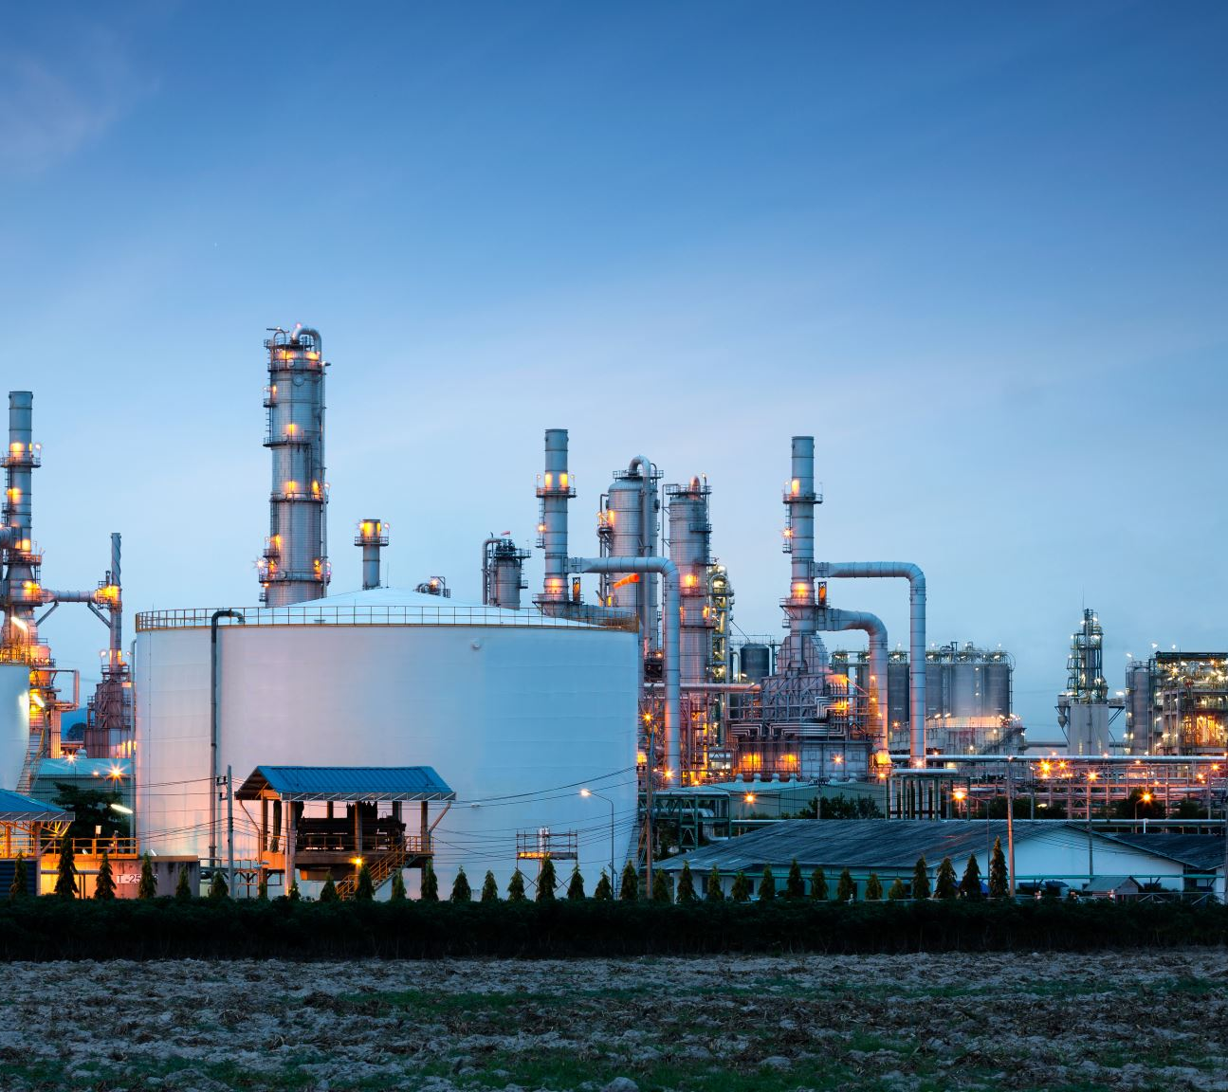
Carbo Pure is an innovative company in the environmental sector throughout Egypt. Carbo Pure specializes in making use of the industrial smoke rather than leaving it to the atmosphere, Carbo Pure products are sold to many sectors throughout the country like the medical sector, green houses, food and beverage sector and etc.

Slide 4
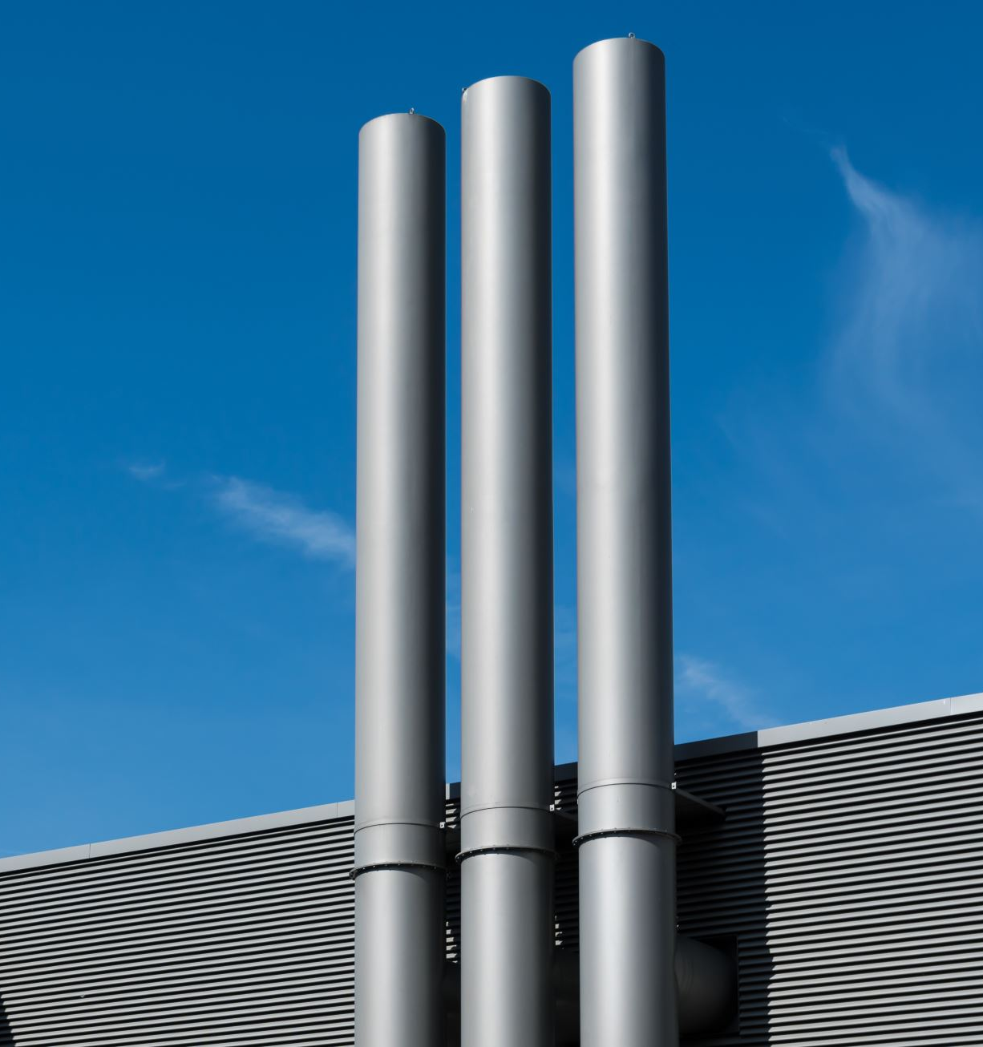
Carbo Pure will solve 60%~70% of the environmental problems caused by industrial smoke emissions, by capturing and restoring the industrial smoke to different useful gases to be used by other industrial sectors and medical sectors.

Slide 5
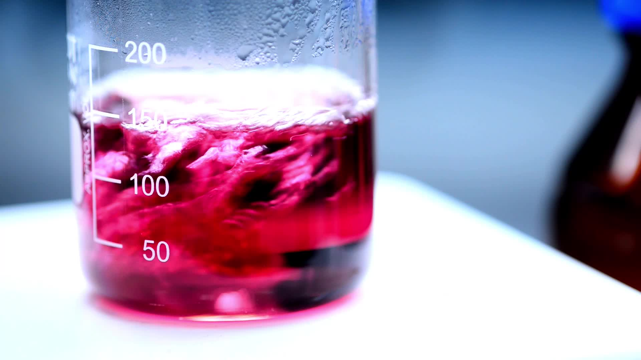
Carbo Pure will make its revenue through the sales of dry ice, hydrogen, carbon and oxygen

Slide 6

Our vision:
"Creating a sustainable environment": Our vision is to reduce carbon emissions from industries to solve global warming and decrease air pollution by transforming industrial air wastes to useful gases for different sectors benefiting the environment and the economy. we envision cleaner air for better way of life.

Slide 7

Our mission:
Drawing down carbon from the atmosphere by filtering and storing industrial smoke, and reintroduce the filtered gases to different industrial and medical sectors. we aim to reduce carbon emissions from the industrial sector and foster a community of environmentally aware individuals.

Slide 8

Our Values:
Sustainability: We prioritize processes that minimizes industrial environmental impact by creating new eco-friendly technology.
Quality: Each gas we restore reflects our commitment to the environment and community.
Community and ethics: We collaborate with different sectors to make use of the restored gases and foster a community of environmentally aware individuals while acting with integrity and transparency.
Collaboration and partnerships: building strong beneficial relationships that benefit the growth of our environmental impact while benefiting all stakeholders.

Slide 9
Targeting:

Slide 10
Target Market:
Focus on achieving profitability in the first year by recycling CO2, nitrogen, and sulphur for use in:
Chemical and Plastic Industries: Large market size, increasing demand for sustainable materials, cost-effective raw materials.
Construction and Concrete Industry: Large economic sector, trend towards sustainable materials, cost reduction, and durability.
Agriculture: Growing market for greenhouses, increased productivity, and sustainable methods.

Slide 11
Marketing mix for CarboPure:

Slide 12
The problem we solve:
Carbo Pure is an innovative company in the environmental sector throughout Egypt. Carbo Pure specializes in making use of the industrial smoke rather than leaving it to the atmosphere, Carbo Pure products are sold to many sectors throughout the country like the medical sector, green houses, food and beverage sector and etc.

Slide 13
Our solution:
Carbo Pure will solve 60%~70% of the environmental problems caused by industrial smoke emissions, by capturing and restoring the industrial smoke to different useful gases to be used by other industrial sectors and medical sectors.

Slide 14
Our revenue:
Carbo Pure will make its revenue through the sales of dry ice, hydrogen, carbon and oxygen
Our target market is the industrial sector where we will extract the gases and restore it, to be used for useful operations in different sectors like medical, industrial and agricultural sectors.

Slide 15
Product:
Advanced technology for capturing factory gases and converting them into useful products:CO2 to solids for use in greenhouses, rubber, asphalt, medicine, groundwater purification, filters, and chemicals.
Oxygen for industrial use.
Hydrogen for oxy-hydrogen technology in welding and alternative energy.
High production standards ensuring efficiency and safety.
Regular training and provision of PPE.
Benefits:
Reduces carbon emissions.
Produces economically valuable materials.
Contributes to environmental protection.

Slide 16
Price:
Pricing based on production, operational, and development costs, as well as the market value of liquid carbon.
Different pricing packages based on production scale and customer needs.
Highlight the economic return for customers using liquid carbon.

Slide 17
Capturing gases directly from high-emission industries and factories.
Partnerships with environmental organizations and governmental bodies.
Online platform for information, support, and product sales.
Selling gases to industries in need.
Place:

Slide 18
Online advertising on social media and environmental websites.
SEO and PPC campaigns to raise awareness and attract potential customers.
Articles and reports in environmental and industrial magazines.
Press conferences and workshops to highlight the technology's benefits and environmental impact.
Free trial offers for companies to experience the technology.
Incentives for companies referring new clients.
Participation in environmental and industrial exhibitions.
Events and discussions to educate the public on the technology's importance and benefits.
Video support from content creators.
Sponsorships for clubs and teams.
Promotion:

Slide 19
Competitors analysis

Slide 20
Direct Competitors:
Carbon Clean Solutions Strengths: Advanced technology, strong industry partnerships, significant funding.
Weaknesses: High cost.
Clime works Strengths: Innovative technology, strong brand, sustainable investment.
Weaknesses: Scalability issues, high operational costs.
Global Thermostat Strengths: Efficient technology, strong partnerships, high environmental impact. Weaknesses: Growth phase, limited market penetration.

Slide 21
Indirect Competitors:
Renewable Energy Companies (e.g., Tesla, Siemens)Strengths: Established market presence, advanced technology, large customer base.
Weaknesses: Focus on energy, not carbon capture.
Waste Management Companies (e.g., Veolia, Waste Management Inc.)Strengths: Strong infrastructure, wide service range, established customer relationships.
Weaknesses: Focus on waste management, not specifically carbon capture.

Slide 22
Competitive Analysis
Carbon Clean Solutions
Quality: 7
Pricing: 4Place: 5Promotion: 8
Clime works
Quality: 8
Pricing: 3
Place: 8
Promotion: 7
Carbo Pure
Quality: 9
Pricing: 6
Place:5
Promotion: 10
Global Thermostat
Quality: 8
Pricing: 5
Place: 2
Promotion: 2
Waste Management Inc, Veolia
Quality: 7
Pricing: 5
Place: 5
Promotion: :
Siemens, Tesla
Quality: 6
Pricing: 5
Place: 7
Promotion: 7

Slide 23

Market Research

Slide 24
Primary Data:
Design and conduct surveys and interviews with potential customers, industrial partners, and experts.
Focus groups to discuss CO2 recycling benefits and challenges.
Field tests to evaluate the effectiveness of CO2 recycling technologies.
On-site analysis at high-emission factories for data on emissions and required liquid nitrogen quantities.
Results and recommendations presented to stakeholders and potential partners.

Slide 25
Survey Findings:
Ages 16-25: 90% from Egypt, Saudi Arabia, UK, and USA.97% believe CO2 recycling can effectively address climate change.
96% are interested in recycling technology.
71% haven't heard of CO2 recycling.69.
7% know high CO2 levels contribute to climate change and could cause cities like Alexandria to disappear by 2050.
77% are interested in participating in a CO2 recycling program.57.9% are aware of Egyptian environmental law No. 4 of 1994, Article 43.71.
1% would adopt our project to reduce taxes.
36.8% understand carbon capture and usage.
68.4% are motivated by environmental responsibility.48.
7% prefer tax incentives to encourage adoption.94.7% believe technology plays a crucial role in combating climate change.
63.2% are interested in financial incentives and environmental impact.
35.5% see high costs as a potential issue.89.5% support implementing our project.
42.1% want more information on environmental impact.98% consider addressing climate change important for businesses today.

Slide 26
Secondary Data:
Review scientific research on CO2 to liquid nitrogen conversion technologies.
Market reports on CO2 recycling and new technologies.
Articles and industrial magazines for current and future trends in carbon recycling.
Governmental and regulatory data on CO2 emissions and recycling incentives.
Examples include articles from WHO, UNEP, WFP, GEF, WAFC, EAI, and UN goals 13 and 17 supporting Carbo Pure's idea.
STP (Segmentation, Targeting, Positioning)Segmentation

Slide 27
Industries Using Captured Gases:
Chemical and Plastic Industries Companies: Chemical and plastic manufacturers using CO2-based raw materials.
Needs: Sustainable raw materials, cost reduction.
Construction Industry Companies: Concrete manufacturers and developers using eco-friendly materials.
Needs: Durable building materials, sustainability.
Energy and Transportation Companies: Fuel manufacturers and transportation companies seeking alternative energy sources.
Needs: Alternative energy, lower costs.
Agriculture and Greenhouses Companies: Intensive farming and agricultural technology firms.
Needs: Increased productivity, sustainable methods.

Slide 28
Industries Using Captured Gases:
Metal and Steel Industries Companies: Steel manufacturers and mining companies.
Needs: Process improvement, cost reduction.
Groundwater Industry Companies: Well drilling and water treatment firms.
Needs: Effective cleaning methods, efficient water purification.
Green Concrete Industry Companies: Concrete manufacturers using sustainable materials.
Needs: Eco-friendly concrete, innovative building materials.
Rubber Industry Companies: Tire manufacturers and synthetic rubber producers.
Needs: Efficient cleaning and cooling, cost-effective production.
Asphalt Industry Companies: Asphalt manufacturers and road maintenance firms. Needs: Effective cooling, efficient cleaning.

Slide 29
Positioning:
Chemical and Plastic Industries:
Value Proposition: Sustainable raw materials, cost reduction.
Messaging: "Carbo Pure transforms waste into valuable resources, providing cost-effective and eco-friendly raw materials."
2. Construction Industry:
Value Proposition: Enhanced material properties, environmental compliance.
Messaging: "Build a greener future with Carbo Pure. Our CO2-enhanced concrete boosts durability and helps meet sustainability goals."
3. Energy and Transportation:
Value Proposition: Alternative energy sources, cost efficiency.
Messaging: "Power up with Carbo Pure. Convert CO2 into valuable fuels, reducing reliance on fossil fuels and cutting costs."
4. Agriculture and Greenhouses:
Value Proposition: Increased crop yield, sustainable farming.
Messaging: "Maximize your harvest with Carbo Pure. Our CO2 solutions enhance photosynthesis, leading to healthier and more productive crops."

Slide 30
Positioning:
5. Metal and Steel Industries:
Value Proposition: Process efficiency, cost savings.
Messaging: "Forge ahead with Carbo Pure. Improve efficiency and sustainability in your metal and steel operations."
6. Groundwater Industry:
Value Proposition: Equipment maintenance, water purification.
Messaging: "Keep your equipment running smoothly with Carbo Pure. Efficient and clean groundwater extraction solutions."
7. Green Concrete Industry:
Value Proposition: Improved concrete quality, innovation in construction.
Messaging: "Revolutionize construction with Carbo Pure. Enhanced concrete quality and sustainable building practices."
8. Rubber Industry:
Value Proposition: Manufacturing efficiency, cost-effective solutions.
Messaging: "Enhance your rubber production with Carbo Pure. Improved efficiency and reduced costs."

Slide 31

General Positioning:
Innovative and Sustainable: Leveraging cutting-edge technology to support a circular economy.
Cost-Effective Solutions: Competitive pricing through the use of recycled CO2.
Environmental Impact: Contributing to global sustainability goals and regulatory requirements.

Slide 32

Strengths:
Advanced Technology:
Solution: Enhance innovation and continue developing technology to improve efficiency.
Commitment to Sustainability:
Solution: Expand partnerships with environmental organizations and government institutions to enhance the sustainable image.
Economic Benefits:
Solution: Market the economic benefits to companies through studies and case examples.

Slide 33

Weaknesses:
High Production Costs:
Solution: Seek solutions to reduce production costs such as improving processes and seeking government funding and support.
Lack of Awareness of Technology:
Solution: Intensify marketing and awareness campaigns to increase understanding of the technology and environmental benefits.
Operational Challenges:
Solution: Continuous training for staff and improving operations management to ensure efficiency and safety.

Slide 34

Opportunities:
Increasing Demand for Environmental Solutions:
Solution: Leverage the growing demand for sustainable products and services to expand the market.
Strategic Partnerships:
Solution: Build partnerships with environmental and industrial institutions to broaden the impact.
Product Innovation:
Solution: Develop new products using extracted materials such as CO2 and hydrogen to meet diverse market needs.

Slide 35

Threats:
Changing Environmental Regulations:
Solution: Constantly monitor environmental regulations and adjust strategies to comply with them.
Competition from Alternative Technologies:
Solution: Focus on continuous innovation and improving technology to maintain a competitive edge.

